Slide 1


Atliq Hardwares
: A financial & sales analysis
2022

Slide 2




Atliq Hardwares
Atliq Hardwares is one of the leading computer hardware producers in India and well expanded in other 26 countries too.
Operates in Asia Pacific, Europe, Northern America and Latin American regions.
Peripherals and Accessories, Network and Storage and Personal Computer are the main 3 divisions.
Agenda
Objective and Data
Generation of insights from past years 2020 and 2021 for better sales forecast.
Analysis of data for decision making and growth of business.
For the expansion of market and target advertising to customers.
Find out various trends on the sales of products based on locations.
Data was collected using the internal sales data during those years.

Slide 3
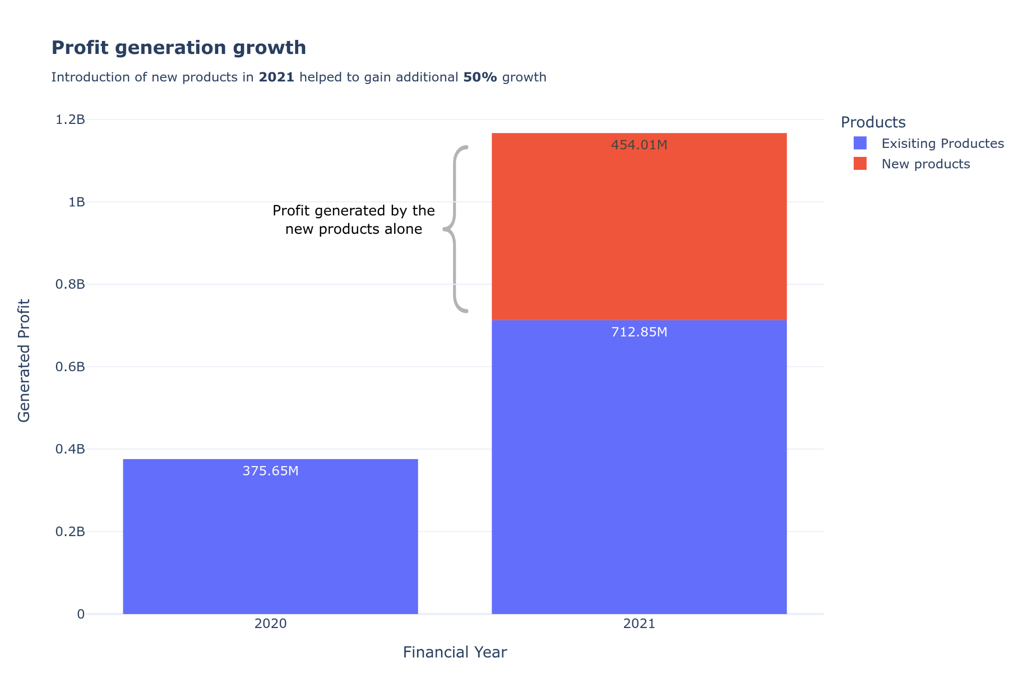
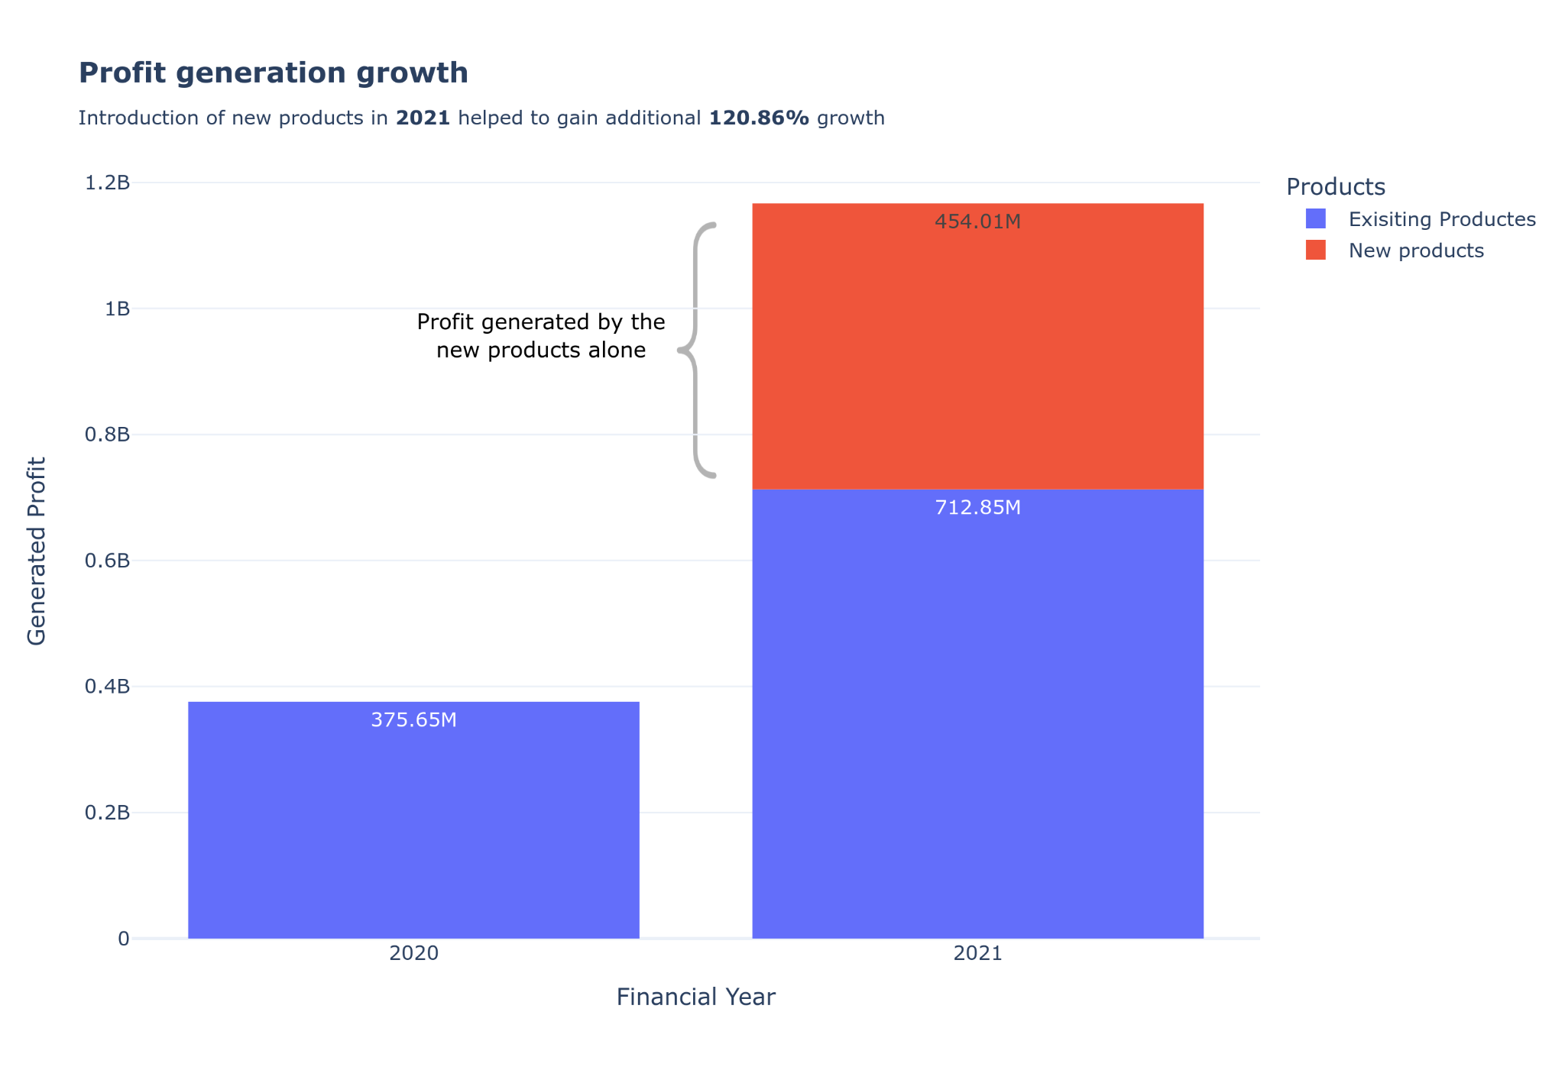
Profit generation over the years
Key takeaways
Recorded a profit of 1.16 Billion in 2021.
Archived a total growth of 210.65% in year 2021.
The introduction of new products helped to gain additional 120% year on year growth.
Customers showed great interest in newly added product list.
New products alone generated more profit than 2020’s combined.

Slide 4
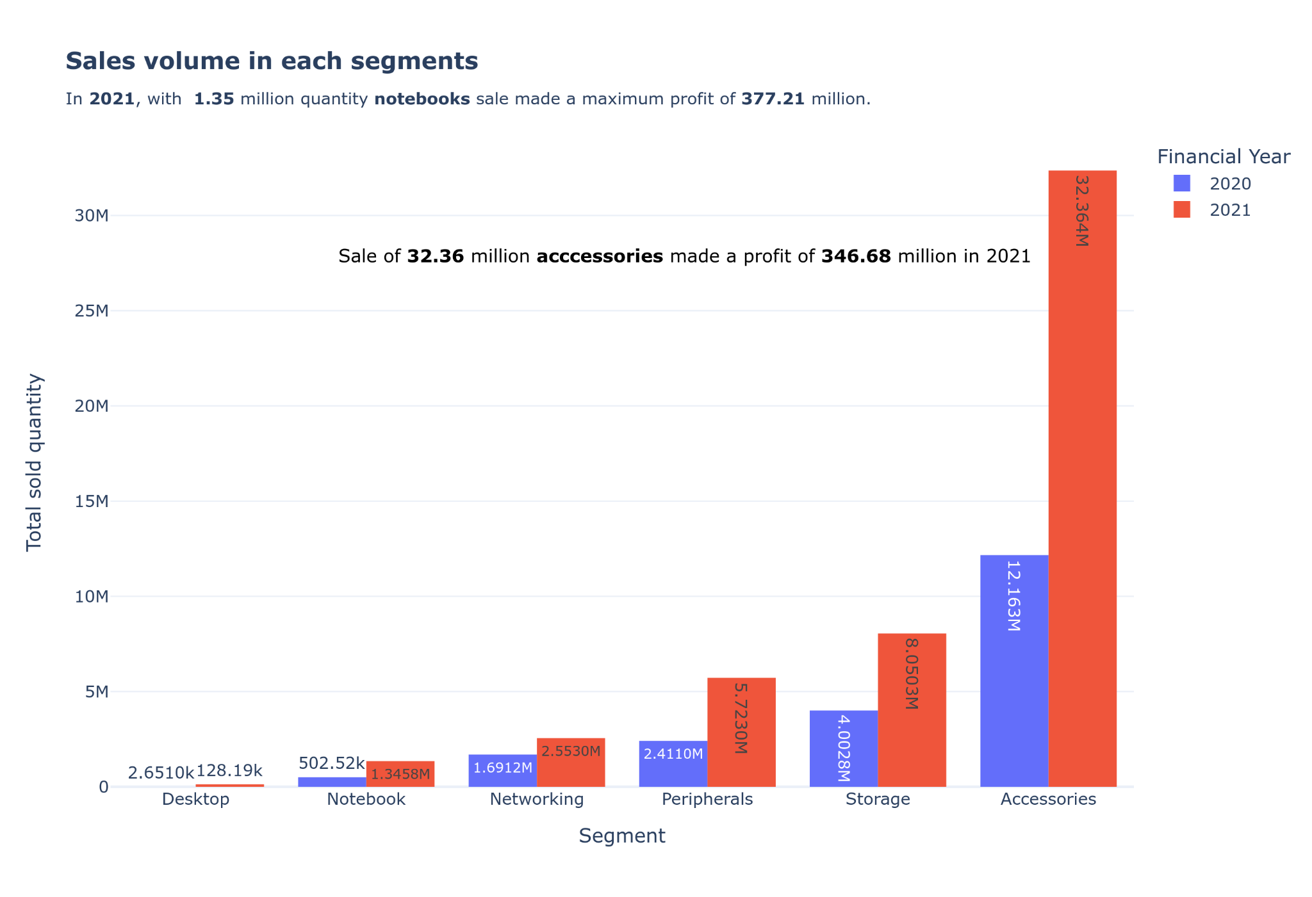
Impact on method of sales
Key takeaways
All the segments showed significant growth in 2021.
Accessories segment recorded a record sale and sold 32.36 million quantity products in 2021.
Notebook segment were ranked 5th in quantity of sales, but generated a maximum profit of 1.35 billion.

Slide 5
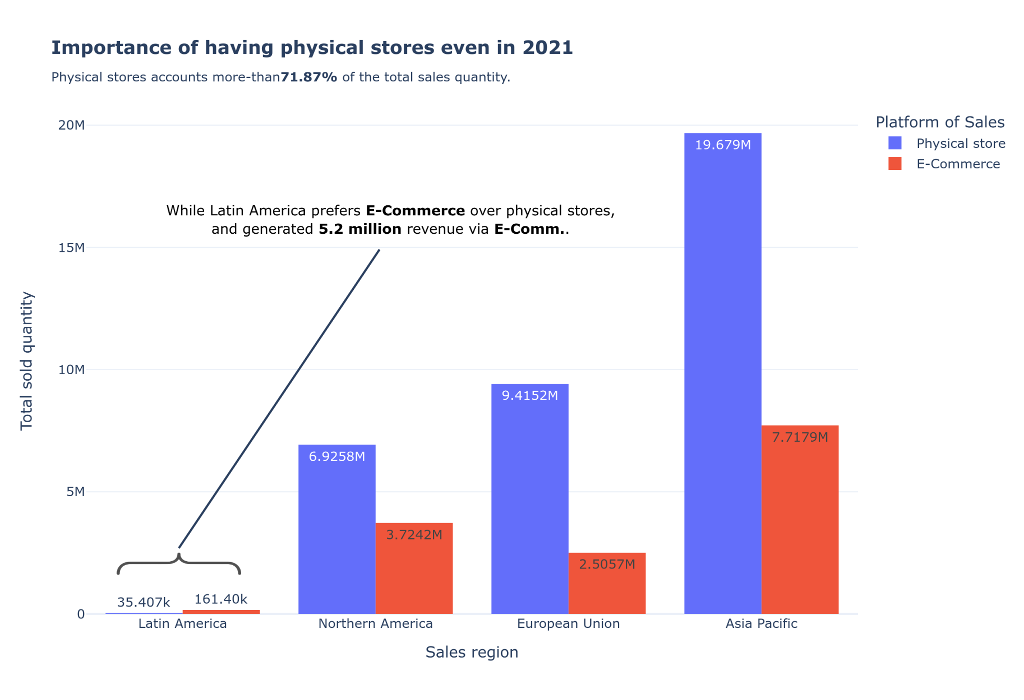
Impact on method of sales
Key takeaways
Customers showed interest in buying more products from physical stores only.
Physical stores constitutes about 71.87% of the total sales.
Only the customers from Latin American region bought more products through E-Commerce platforms.
Except Latin American region giving offers on offline stores may increase the sales.
For Latin American it would be great to show online ads to increase sales.

Slide 6
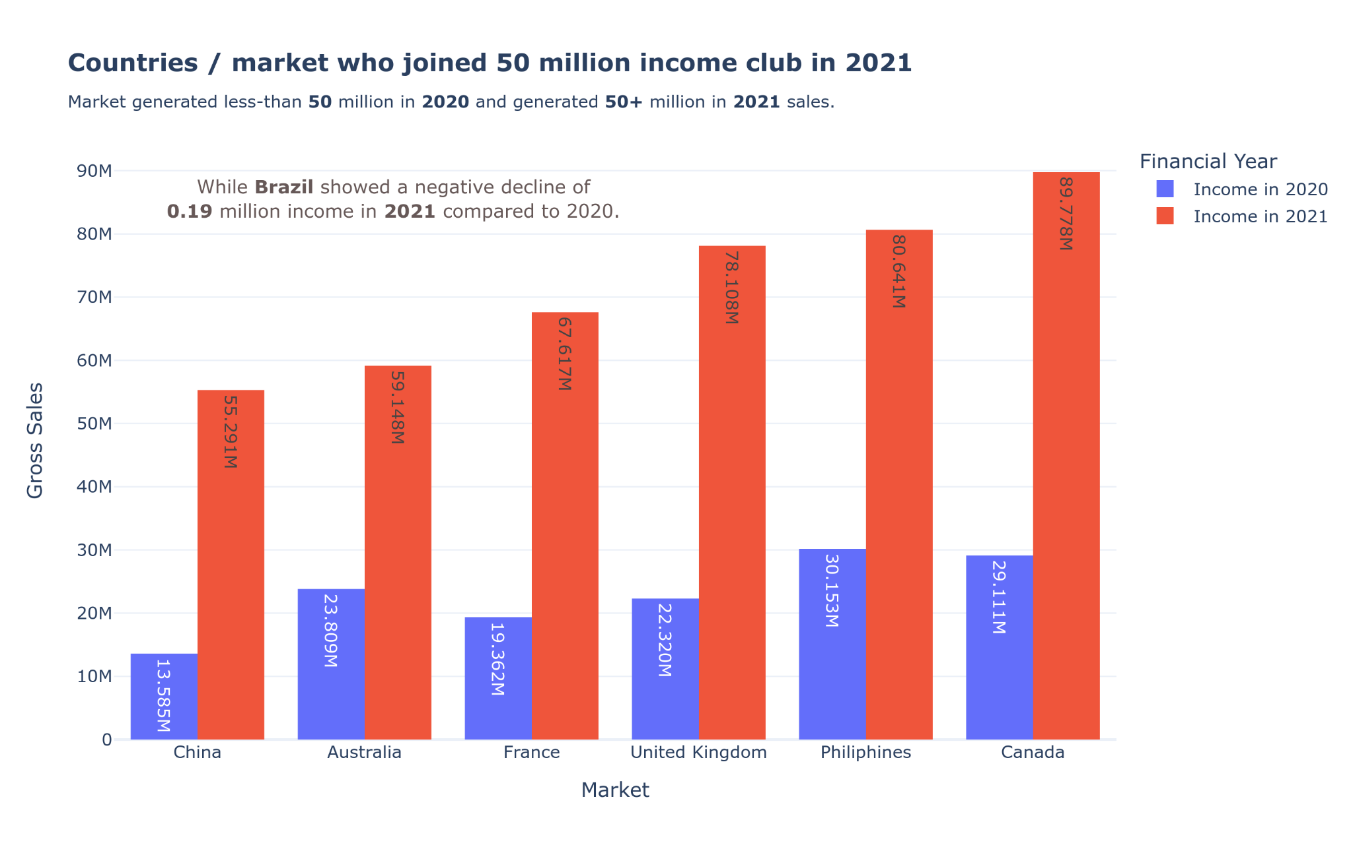
Impact on method of sales
Key takeaways
Majority of the market showed a positive sales in 2021 compared to 2020.
6 new markets generated 50+ million sales in 2021.
Brazil indicated a negative growth in sales, 0.19 million of business lost in 2021 .
A gross sales of 100 million was archived by 3 countries and those are India, USA and South Korea.
India and USA generated a sale of 455.05 million and 264.46 million respectively.

Slide 7
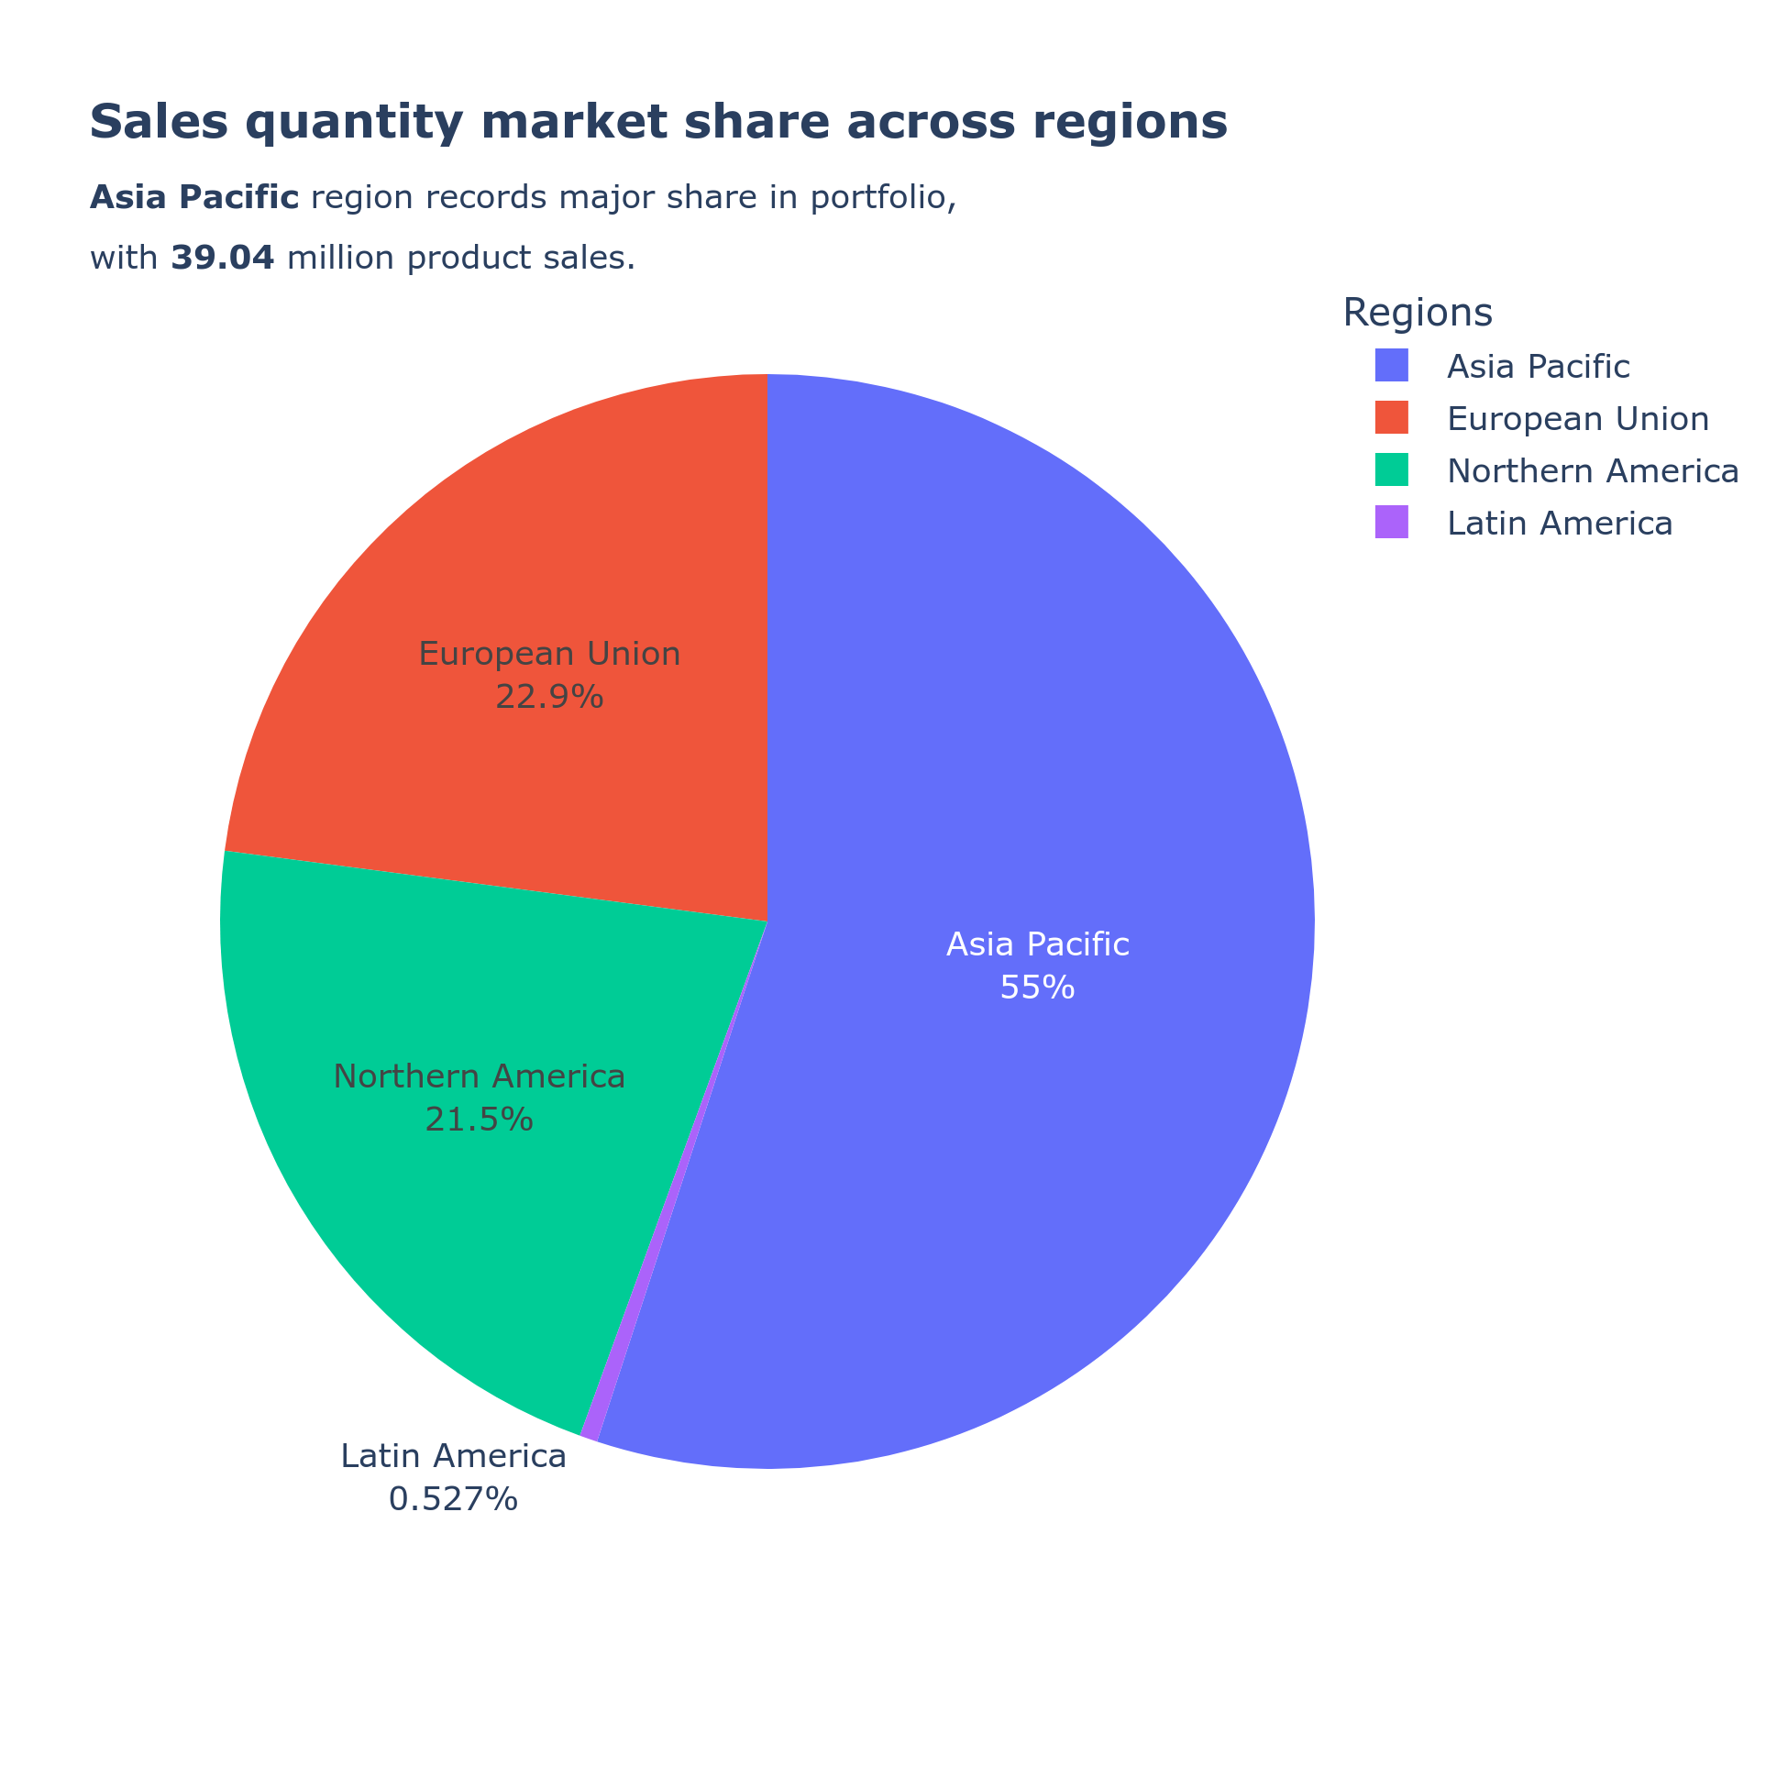
Sales volume across the glob
Key takeaways
The large quantity of products was sold in Asia Pacific region only.
India is the largest consumer among Asia Pacific region.
Latin America is the region where the sales volume is low.
Brazil made a negative growth of sales in 2021.

Slide 8
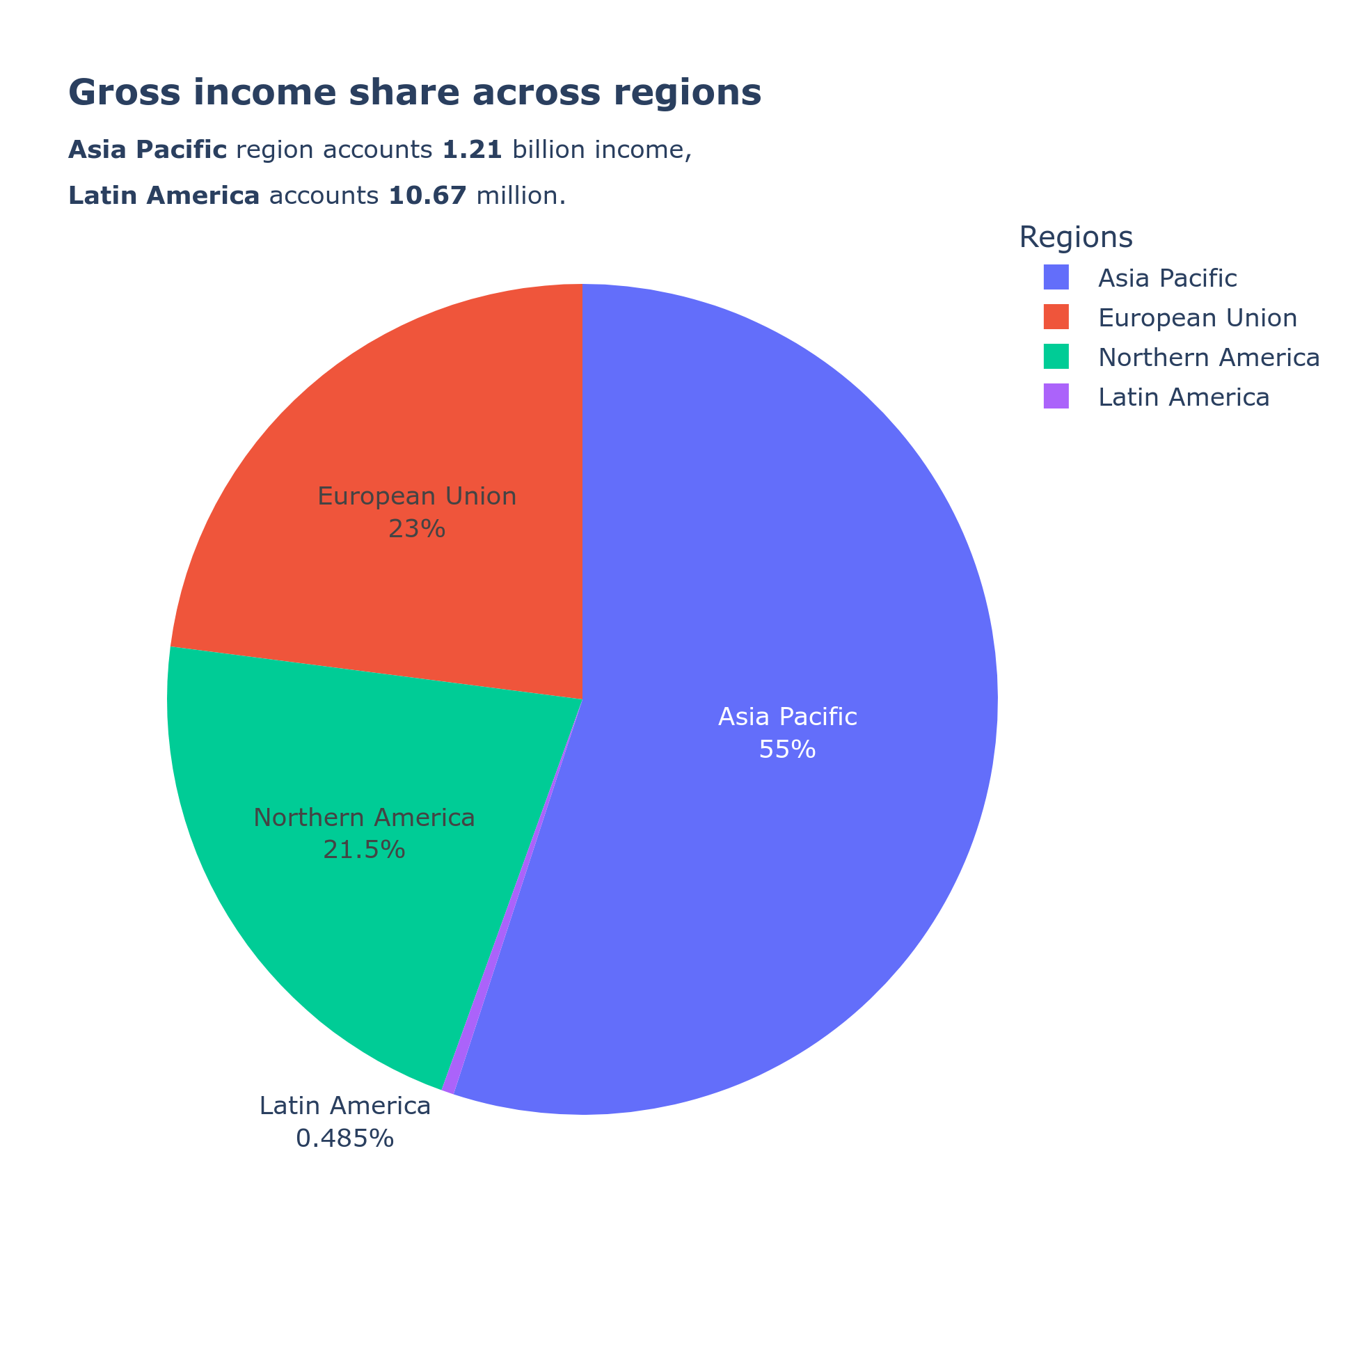
Sales volume across the glob
Key takeaways
Asia Pacific region generated largest income for the company with high sales volume.
The large quantity of products was sold in only.
India alone in the Asia Pacific region generated more than 455 millions of revenue..
In Latin American country there were less volume of sales happened and Brazil made negative growth in 2021.

Slide 9




Summary
There is significant growth in 2021 compared to 2020, and recorded around 210% growth.
Customers really showed interest in the newly introduced products.
The Asia Pacific region is the largest consumer.
Even in 2021, the sales though physical stores is higher than the E-Commerce.
In Latin American region promoting the products through the online media probability will help to grow more over there.
Focusing more on Northern American region could also generate more sales because USA is the second largest customer.

